Slide 1
Sampling and Inference
Background: #FCF7E4
Heading #4E75A3
Text #595959
Highlight #DD7E0E

Slide 2


Slide 3
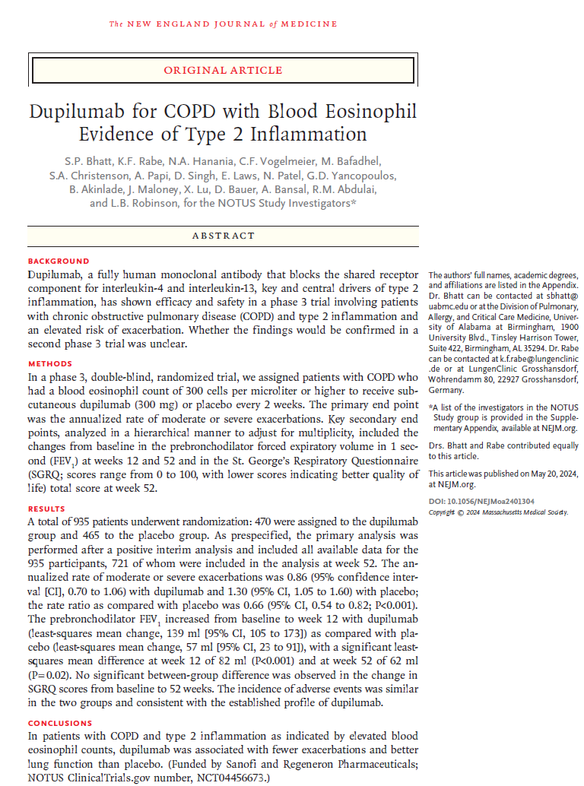



Estimands, Estimators and Estimates
Each clinical trial should address a clearly-defined clinical question (Estimand) considering the following criteria:
Target Population
Treatment
Who will receive the medicine?
Patients with COPD and blood eosinophil count >300 cells per µL
Clinical intervention:
Dupilumab 300mg Q2W compared with placebo
Endpoint
Clinical Outcome, Biomarker etc.
Change from baseline in FEV₁ at Week 12
Summary Measure
ratio
Test Statistic
Difference in means (dupilumab – placebo)
%
Σ
Some example estimands:
“The average difference in 12-week change from baseline FEV₁ if all patients in the target population were prescribed treatment versus if the same patients were not prescribed treatment.”
“The average difference in 12-week change from baseline FEV₁ if all patients in the target population adhered to treatment versus if the same patients were not treated.”
Notes:
The estimands is an abstract question and cannot be observed directly.
We cannot

Slide 4
Estimands, Estimators and Estimates
Let’s choose the following estimand:
“The average difference in 12-week change from baseline FEV₁ if all patients in the target population were prescribed treatment versus if the same patients were not prescribed treatment.”
All patients prescribed new treatment:
compared to:
All patients not prescribed new treatment:
Problem | Solution
We can’t study the whole target population. | We study a representative sample in a clinical trial.
If we prescribe the new treatment to a patient, we don’t know what outcome we would have observed, had they not been prescribed the new treatment (the “counterfactual problem”). | We use randomisation.
Notes:
The estimand statement describes a causal relationship between prescribing the new treatment and the endpoint
Taking a representative sample of the target population provides a practical solution via a clinical trial, but introduces some challenges as we shall see.
Assigning each patient randomly to either the new treatment or control does not solve the “counterfactual” question a patient level e.g. if a patient is assigned to a new treatment, we don’t know what the outcome would have been if they had been assigned to the control. Each patient is either prescribed the new medicine or not.
But this does solve the problem on average, at a group level.
Comparing the groups addresses the estimand question.
We might say that randomisation lets one group act as the missing ‘what if’ for the other.

Slide 5


Estimands, Estimators and Estimates
 | Estimand The question the study is aiming to address: “The average difference in 12-week change from baseline FEV₁ if all patients in the target population were prescribed treatment versus if the same patients were not prescribed treatment.” This value is assumed to be fixed but unknown.
 | Estimator Statistical method used to estimate this quantity: “Least-square mean difference (dupilumab – placebo) for change from baseline in trough FEV₁ at Week 12 obtained from a MMRM model”
 | Estimate The observed value of the estimator in the current study. “LSM mean difference = 100 mL”
$$θ$$
$$\hat{θ}$$
Notes:
This type of estimand is also known as an Intent to treat analysis.
It measures the effect of prescribing the medicine versus not prescribing the medicine (regardless of whether the patients adheres to treatment).
It is generally favoured by regulators, but tends to produce a smaller treatment effect.
Alternative approaches include:
“The treatment difference in the hypothetical condition that all patients adhere to the treatment”
“The treatment difference in the hypothetical situation where rescue medication was not taken”
The method used for the estimator depends on the estimand, e.g. handling data after the patient withdraws from study medication or starts taking rescue medication.
Other events need to be considered, e.g. how to handle death, transplant or surgery depending on the disease area.

Slide 6
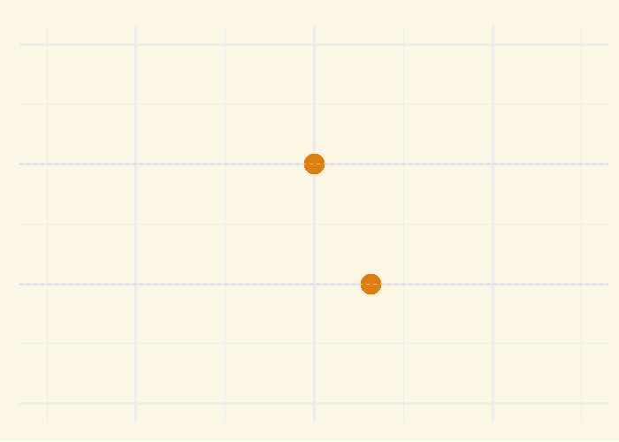


Standard Error
If we imagine repeating the study many times, on average the Estimate would tend to match the Estimand, but the exact value would vary between studies.
A measure of how much the Estimate varies between repeated trials is the Standard Error.
It depends on the number of patients in the study, and the overall variability of outcomes between patients.
So, given the Estimate we observe in our study results, what we can say about the Estimand (which is fixed but unknown)?
$θ$ Estimand
$\hat{θ}$ Estimate
Notes:
The example is based on our example study, assuming the true treatment effect is 100 and with 250 patients per arm.
Each frame in the animation represents a repeated clinical trial.
The variability is less if we increase the sample size.
This looks like the familiar “bell-shaped curve” but is actually a T-distribution (discovered by a statistician working at Guiness!).

Slide 7
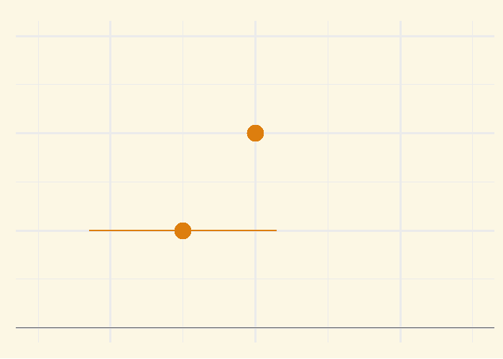


Confidence Interval
$$\hat{θ}$$
$$θ$$
We can construct a 95% confidence interval around our Estimate.
If we imagine repeating the study many times, the confidence intervals would include the Estimand 95% of the time.
$θ$ Estimand
$\hat{θ}$ Estimate

Slide 8
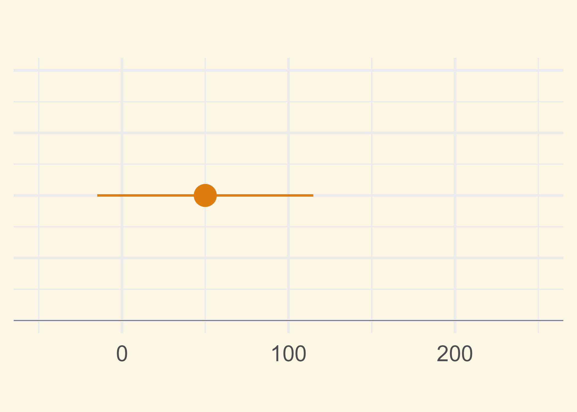
Confidence Interval
Of course in practice, the Estimand is unknown, and we observe only a single Estimate and 95% confidence interval in our study.
We can interpret the confidence interval as representing plausible values for the Estimand, given the results of our study.
Because the Estimand is a fixed value (albeit unknown), it is not random and therefore does not have a probability distribution.
We should therefore avoid statements such as:
“The treatment effect has a 95% probability of being within the interval”
Notes:
There is another statistical approach called Bayesian inference. In this approach, the Estimand is not fixed but is a random variable.
The interval produced in a Bayesian analysis is called a Credible Interval, and this time it can be interpreted in terms of the Estimand having a probability of being within the interval.

Slide 9
Confidence Interval
More on the interpretation of confidence intervals:
Weak effect
Moderate
effect
Strong effect
Because of the properties of the 95% CI, we can make the following statements:
“Plausible values for the true treatment effect are between 40 and 124 mL.”
“A range of treatment effects between 40 and 124 mL is compatible with the trial data.”
“The CI includes values that may be too small to be clinically meaningful.”
“Because the 95% CI excludes zero, the results are statistically significant.”
Notes:
There is another statistical approach called Bayesian inference. In this approach, the Estimand is not fixed but is a random variable.
The interval produced in a Bayesian analysis is called a Credible Interval, and this time it can be interpreted in terms of the Estimand having a probability of being within the interval.

Slide 10



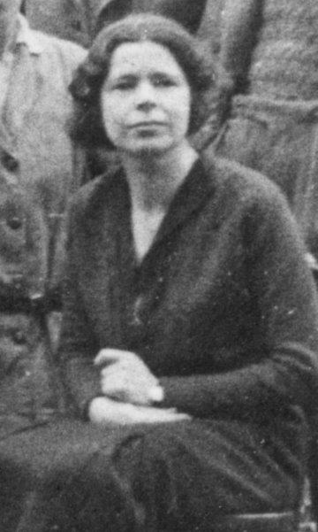
Tea Break
In the early 1920s, Ronald Fisher was working as a statistician at an agricultural research station. One afternoon he made a cup of tea for colleague Muriel Bristol, pouring some milk into a cup and adding tea to it.
“I won’t drink that”, she declared . She only drank tea if the milk was added second.
Fisher was sceptical, but being a statistician, decided to run a test.
He made eight cups of tea, four tea-first and four milk-first, presenting them in random order and letting her guess which were the four “Tea-first” cups.
Ronald Fisher
Actual Drink
Muriel’s Guess
T | M | M | T | T | M | T | M
Muriel Bristol

Slide 11
Tea Break
In the early 1920s, Ronald Fisher was working as a statistician at an agricultural research station. One afternoon he made a cup of tea for colleague Muriel Bristol, pouring some milk into a cup and adding tea to it.
“I won’t drink that”, she declared . She only drank tea if the milk was added second.
Fisher was sceptical, but being a statistician, decided to run a test.
He made eight cups of tea, four tea-first and four milk-first, presenting them in random order and letting her guess which were the four “Tea-first” cups.
Ronald Fisher
Actual Drink
Muriel’s Guess
T | M | M | T | T | M | T | M
T | M | M | T | T | M | T | M
To everybody’s surprise, she got all guesses correct!
Muriel Bristol

Slide 12
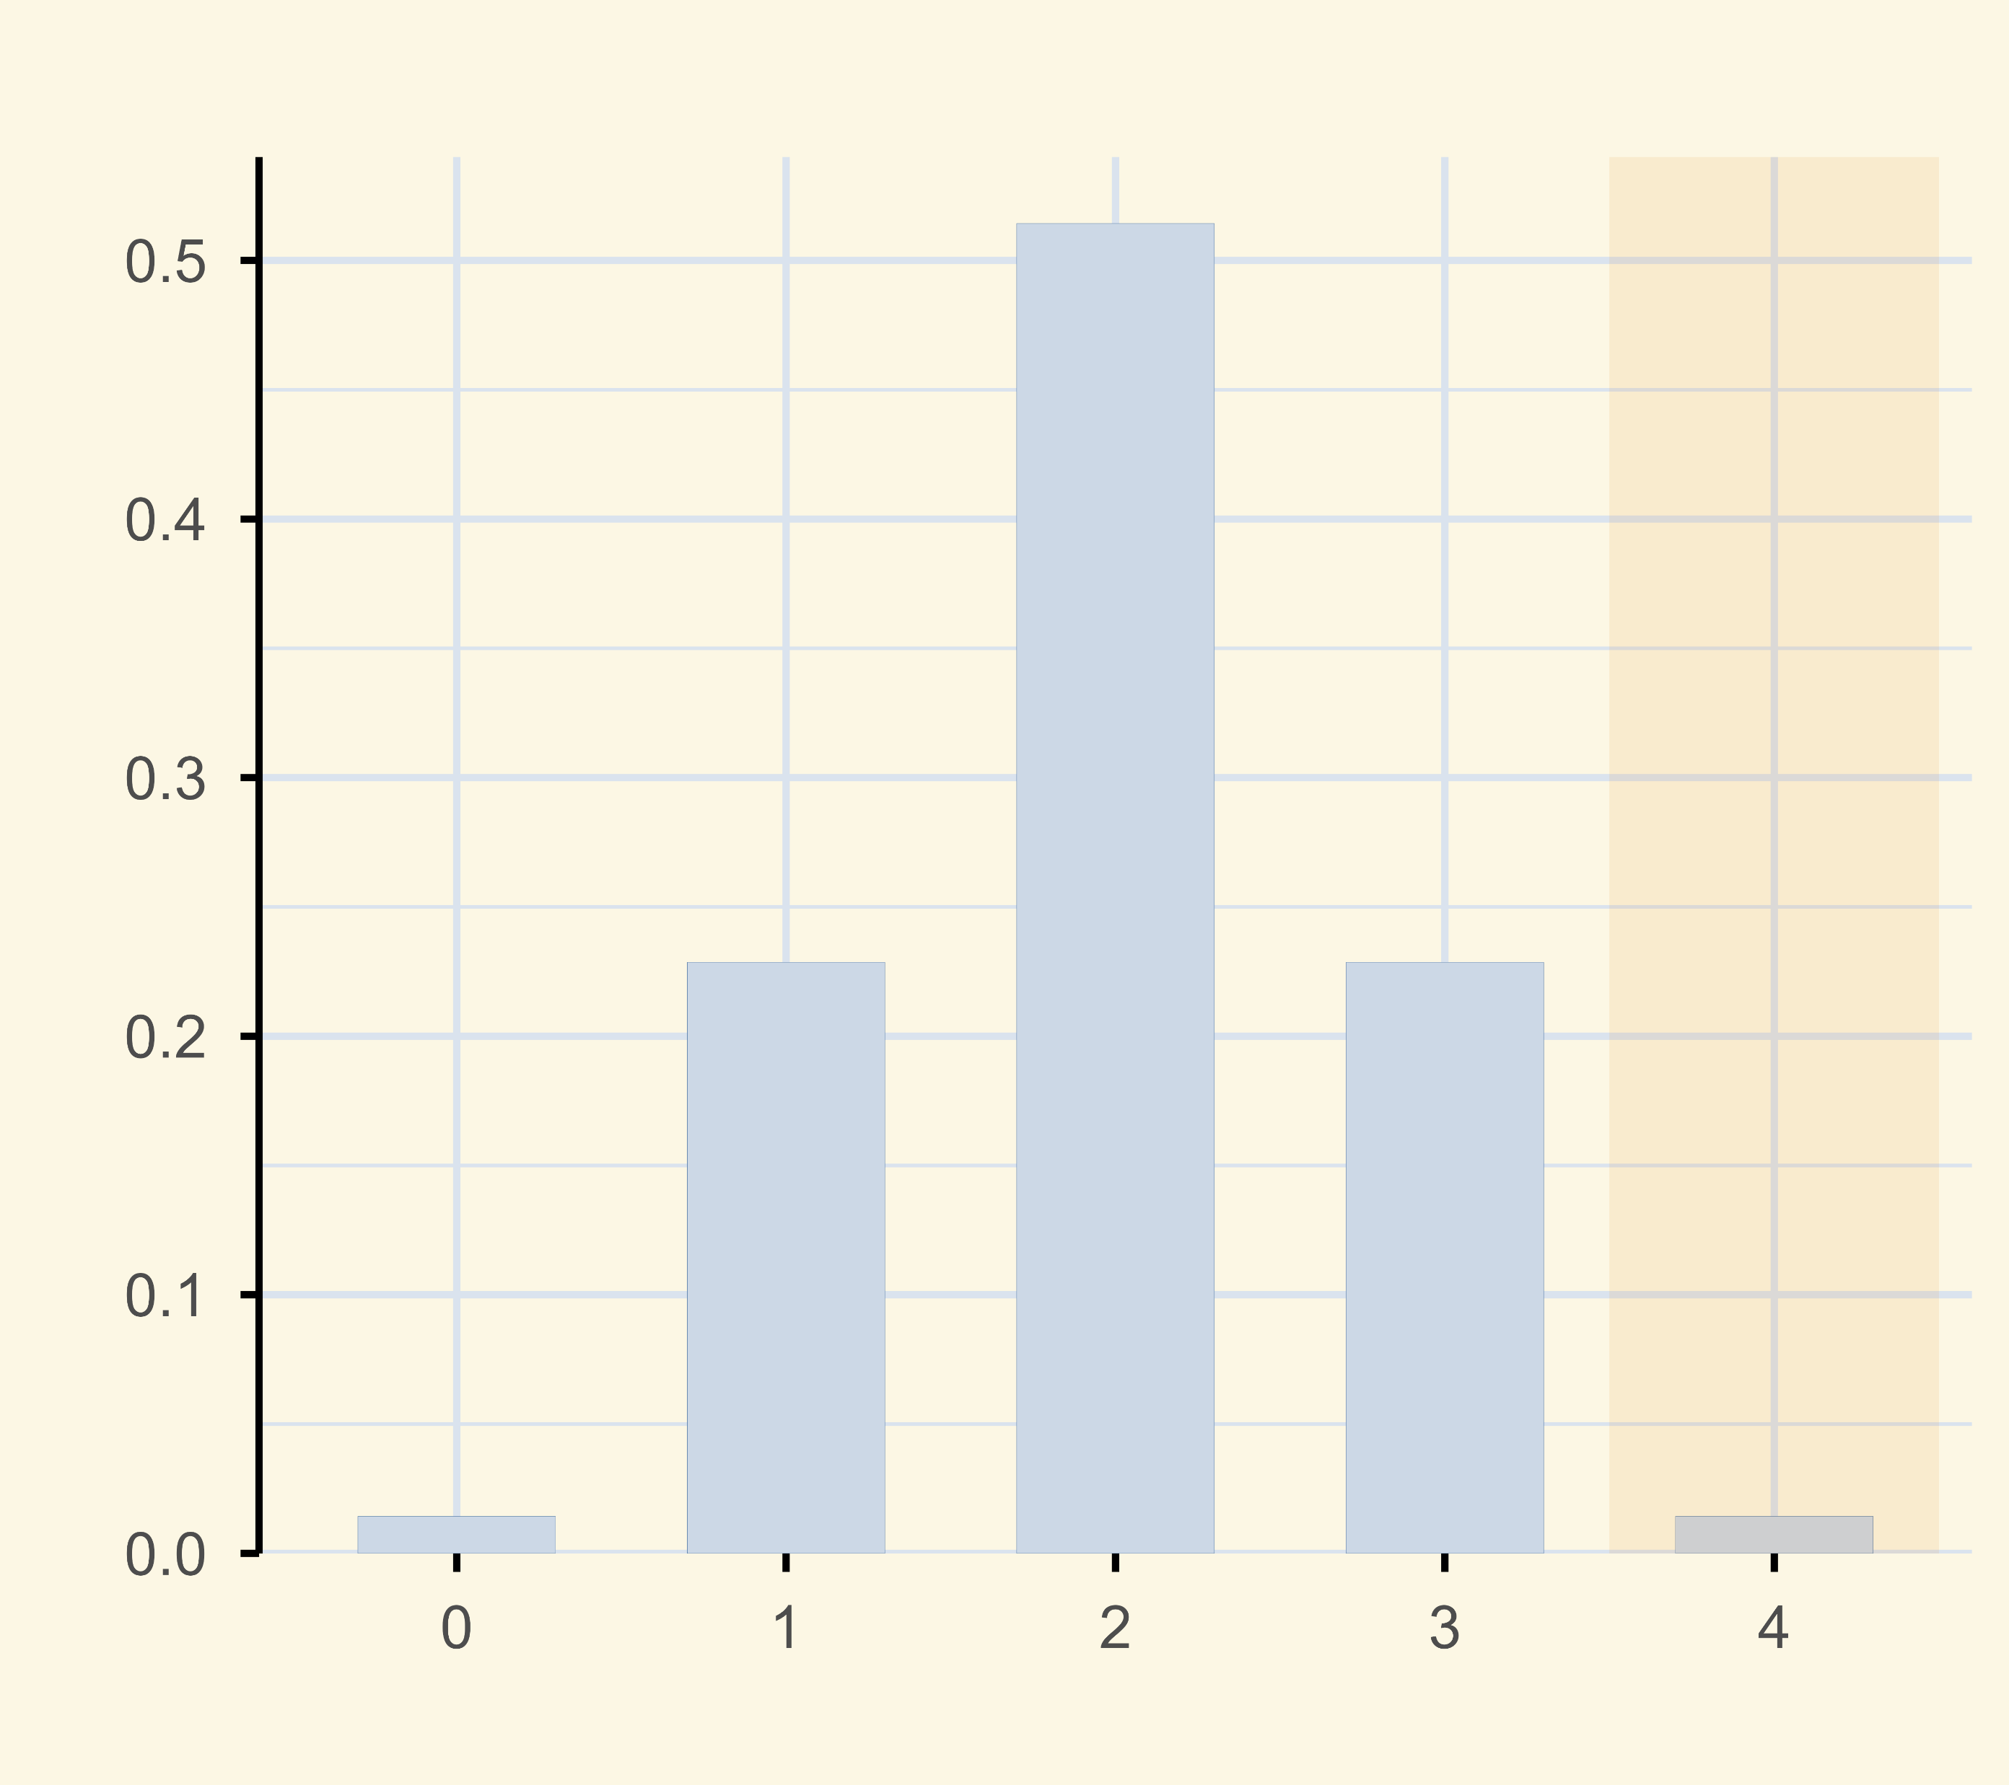
The Null Hypothesis and p-Values
Fisher first hypothesised that Muriel was guessing at random, and called it the “null hypothesis”.
He then calculated that if the null hypothesis was true, the probability of the observed result was 1 in 70.
Because this probability is very small, Fisher concluded that we can reject the null hypothesis, and conclude that Muriel was able to tell the difference between “Tea first” and “Milk first” cups.
Probability of different results
(null hypothesis)
What is a p-value?
A p-value tells you how likely is the result we observed, if in truth there’s no effect. A small p-value means the observed result would be surprising, if the null hypothesis were true.
P-values can provide insight into experimental results, alongside other statistics.
Probability
p=0.014
Number of Correct Guesses
Notes:
This was one of the first recorded examples of a p-value.
It turns out that when you pour milk into boiling hot tea, the first drops of milk get superheated quickly and globules containing fats and proteins acquire a burnt flavour, which Muriel could taste.
Using Fisher’s approach, the p-value isn’t generally compared to a fixed threshold, i.e. there isn’t the concept of “statistical significance”.
Nor is an alternative hypothesis defined – this development came later.
A common fallacy is that the p-value is the probability that the null hypothesis is correct. But this wrong, because a p-value is defined only if the null hypothesis is correct.

Slide 13
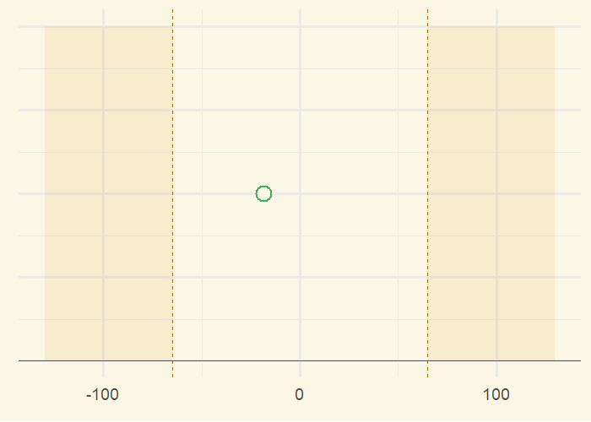
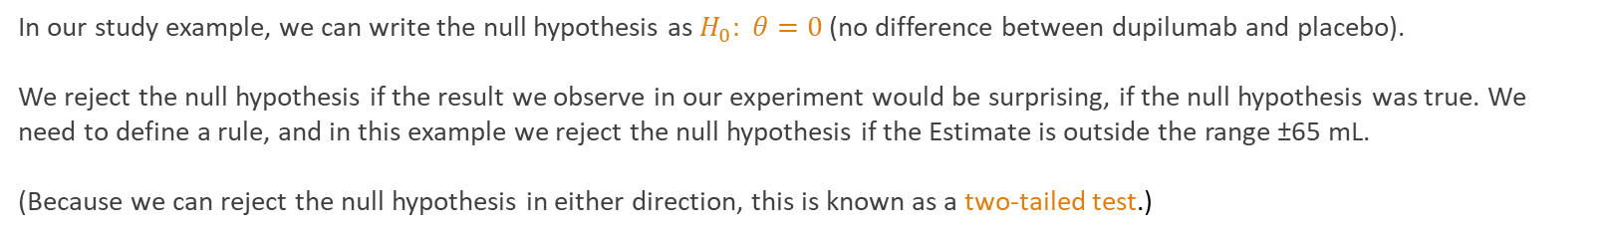
False Positives
In our study example, we can write the null hypothesis as $H_{0}: θ=0$(no difference between dupilumab and placebo).
We reject the null hypothesis if the result we observe in our experiment would be surprising, if the null hypothesis was true. We need to define a rule, and in this example we reject the null hypothesis if the Estimate is outside the range ±65 mL.
(Because we can reject the null hypothesis in either direction, this is known as a two-tailed test.)
If the null hypothesis is true (no effect)…
We might still observe an Estimate outside the range ±65 mL by chance. This is known as a False Positive (or “Type I”) error. Because it leads to a false conclusion, we want this to occur with a low probability.
In this simulation, sometimes we see a type I error (shown in red). How often does this occur?
A statistician will usually plan the analysis so that the false positive rate is one in every 20 trials.
Reject the
null hypothesis
Accept the
null hypothesis
Reject the
null hypothesis
Mean difference CFB FEV₁ at Week 12 (mL)
Notes:
Drug regulators want the type I error to be quite low, because a spurious positive result could mean granting a licence to an ineffective drug.

Slide 14
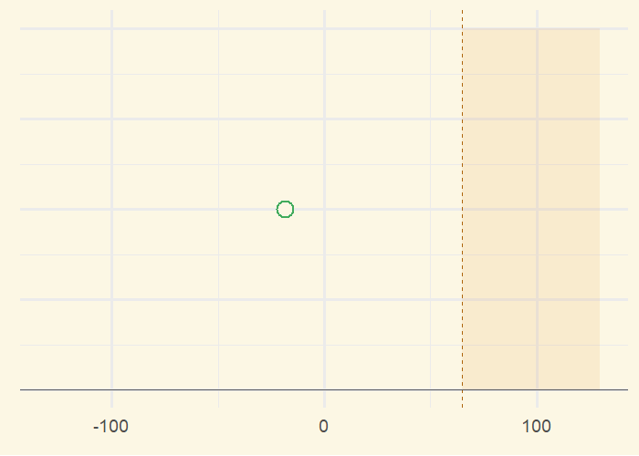
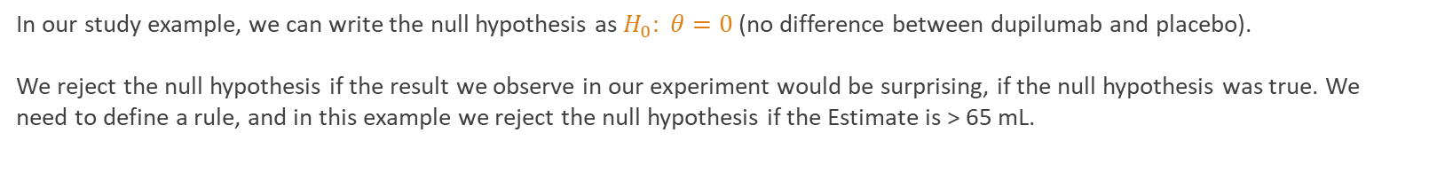
False Positives
In our study example, we can write the null hypothesis as $H_{0}: θ=0$(no difference between dupilumab and placebo).
We reject the null hypothesis if the result we observe in our experiment would be surprising, if the null hypothesis was true. We need to define a rule, and in this example we reject the null hypothesis if the Estimate is > 65 mL.
If the null hypothesis is true (no effect)…
We might still observe an Estimate outside the range ±65 mL by chance. This is known as a False Positive (or “Type I”) error. Because it leads to a false conclusion, we want this to occur with a low probability.
In this simulation, sometimes we see a Estimate with a type I error (shown in red). How often does this occur?
A statistician will usually plan the analysis so that the false positive rate is one in every 20 trials.
Accept the
null hypothesis
Reject the
null hypothesis
An alternative approach is a one-tailed test.
Mean difference CFB FEV₁ at Week 12 (mL)
Notes:
Drug regulators want the type I error to be quite low, because a spurious positive result could mean granting a licence to an ineffective drug.

Slide 15
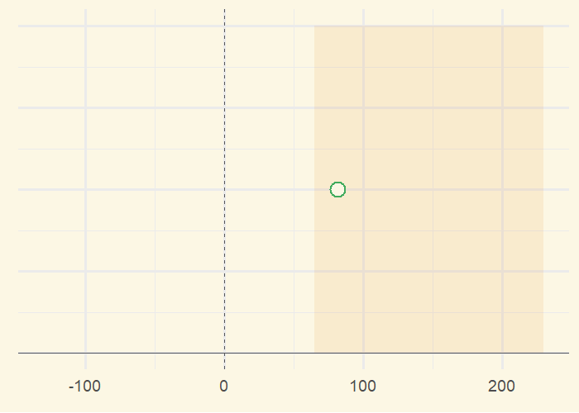
Alternative Hypothesis
Consider the scenario where dupilumab is superior to placebo. We define this as the alternative hypothesis: $H_{1}: θ>0$
We still test against the null hypothesis, i.e. reject if the Estimate > 65mL, but this time we want it to occur with a high probability.
If the alternative hypothesis is true (positive treatment effect)…
We might still observe an Estimate below 65 mL by chance. This is known as a False Negative (or “Type II”) error. Because it leads to a false conclusion, we want this to occur with a low probability.
In this simulation, sometimes we see an Estimate with a type II error (shown in red). How often does this occur?
A statistician will usually plan the analysis so that the false positive rate is one in every 10 trials.
Accept the
null hypothesis
Reject the
null hypothesis
Notes:
This example assumes 250 patients per arm.

Slide 16
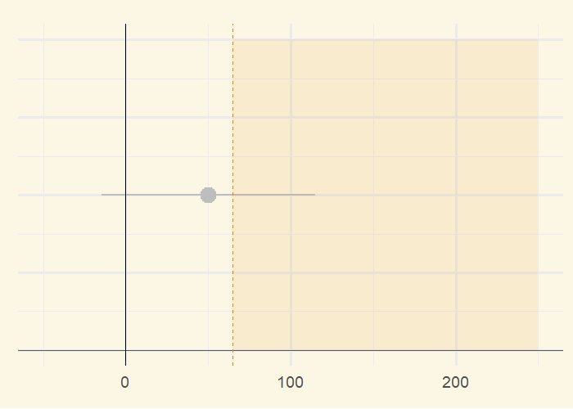
From Tea Test to T-Test
Reject the
null hypothesis

Slide 17
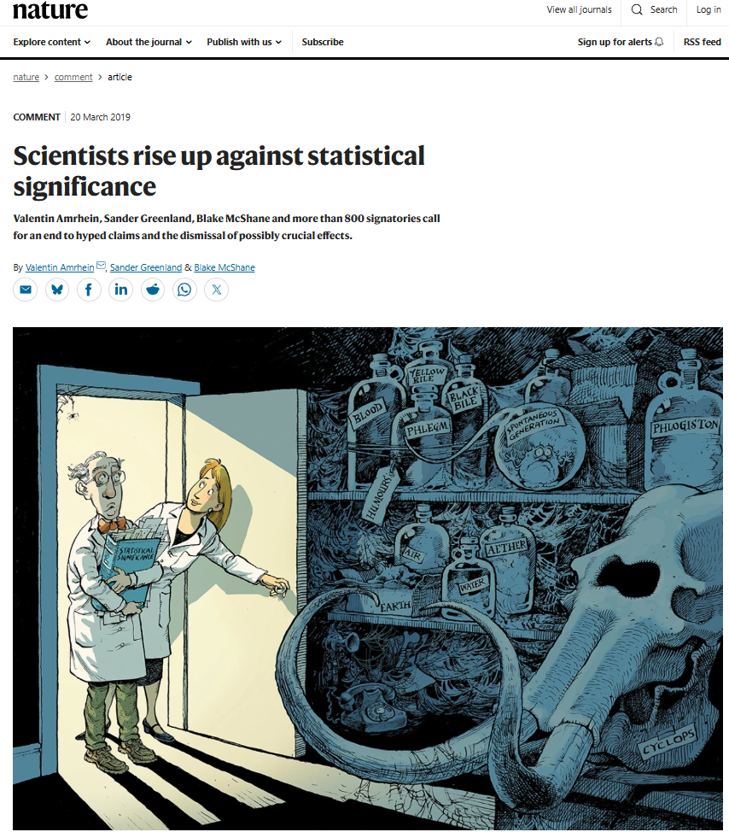
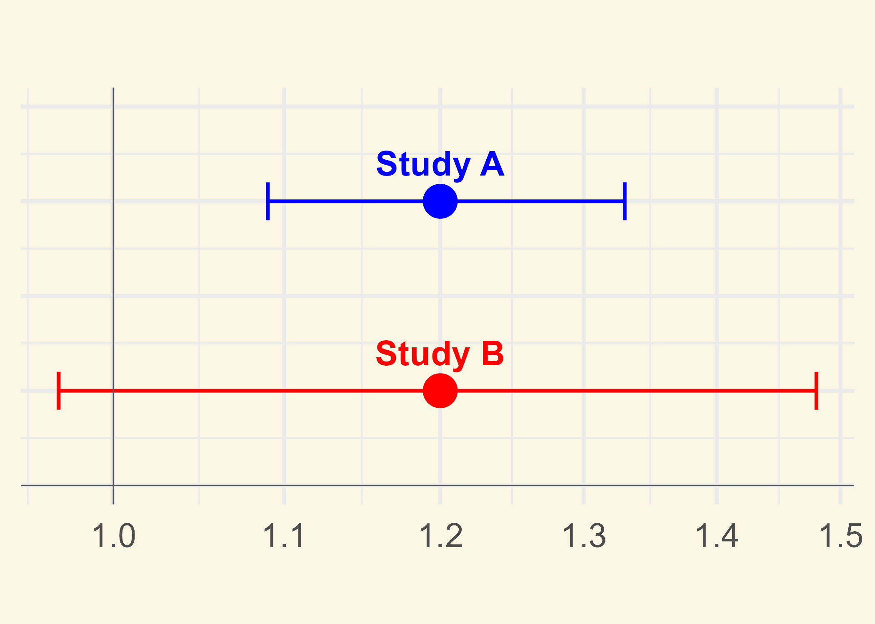
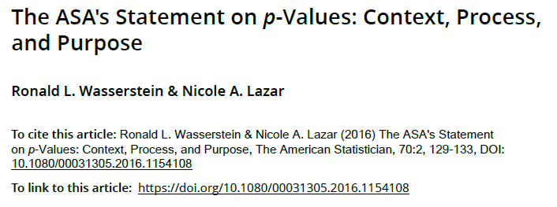
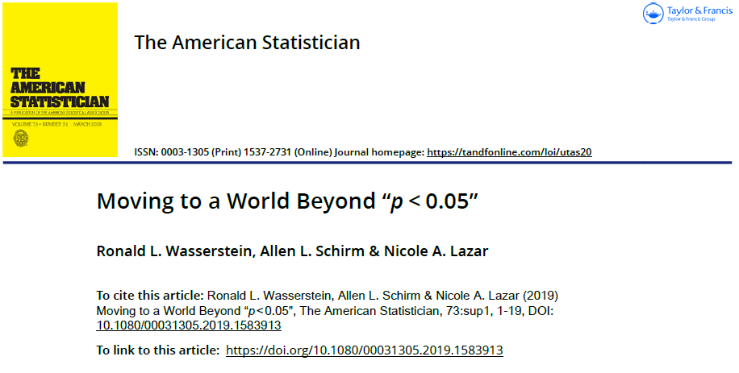
From Tea Test to T-Test
p-values can have a useful role in the scientific and medical literature, but use of “statistically significance” creates as an artificial yes/no dichotomy is controversial and a topic of recent debate.
Case Study
In a safety analysis for an anti-inflammatory drug, results for study B were “statistically non-significant” (p=0.091), with a conclusion “exposure was not associated with atrial fibrillation”.
However study A has previously showed a statistically significant outcome (p=0.0003) with exactly the same estimate of 20% increase in risk!
No
Effect
Increased
Effect
However p-values are relevant in the context of dichotomous decision-making by health authorities. Regulatory approval generally requires a pivotal trial with p<0.05 in the primary endpoint.
Don’t say:
“There is no effect because p > 0.05”
“p-value is the probability the treatment has no effect”
“Statistical significance is proof of clinical importance”
“A smaller p-value means one treatment is better than another”

Slide 18
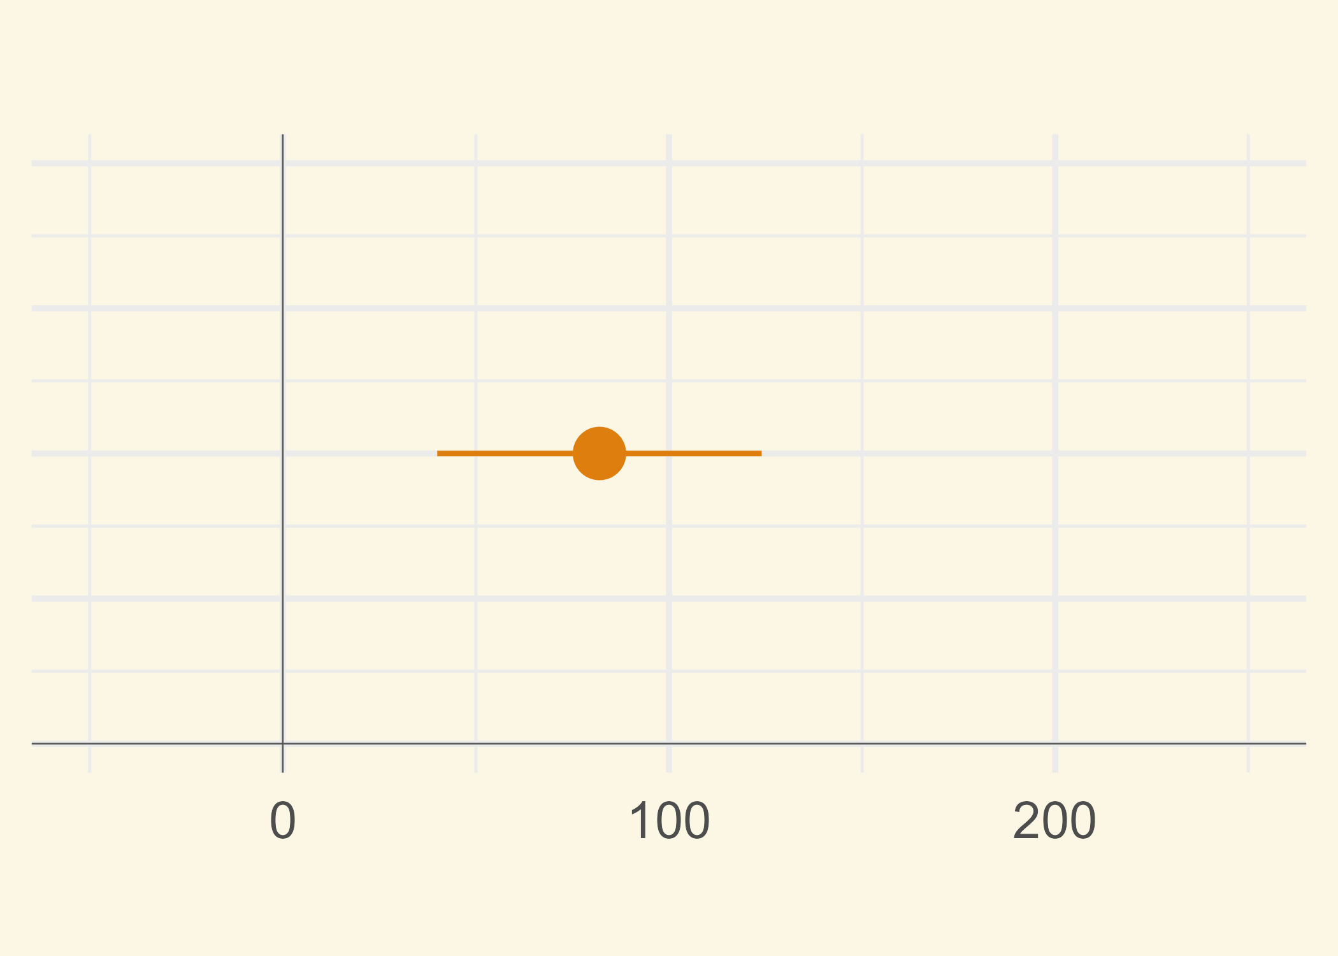


Sampling and Inference
Back to our case study, we are interested in interpreting the results from a single trial.
Remember, the true treatment effect ( ) is unknown.
The study results provide the estimate ( ) and 95% confidence interval (CI).
$$θ$$
$$\hat{θ}$$
Endpoint | Placebo (N=465) | Dupilumab (N=470)
Change in pre-brochodilator FEV1 from baseline to wk 12
Least-squares mean change (mL) | 57 | 139
Least-squares mean difference vs, placebo (95% CI) (mL) |  | 82.0 (40 to 124)
Because of the properties of the 95% CI, we can make the following statements:
“Plausible values for the true treatment effect are between 40 and 124 mL.”
“A range of treatment effects between 40 and 124 mL is compatible with the trial data.”
“The CI includes values that may be too small to be clinically meaningful.”
“Because the 95% CI excludes zero, the results are statistically significant.”
Weak effect
Moderate
effect
Strong effect
Don’t say:
“The true effect lies in the interval with 95% probability.”
“The treatment works for 95% of patients”.
“The CI captures 95% of individual patient outcomes”.
Pre-bronchodilator FEV1 change from baseline (mL)

Slide 19
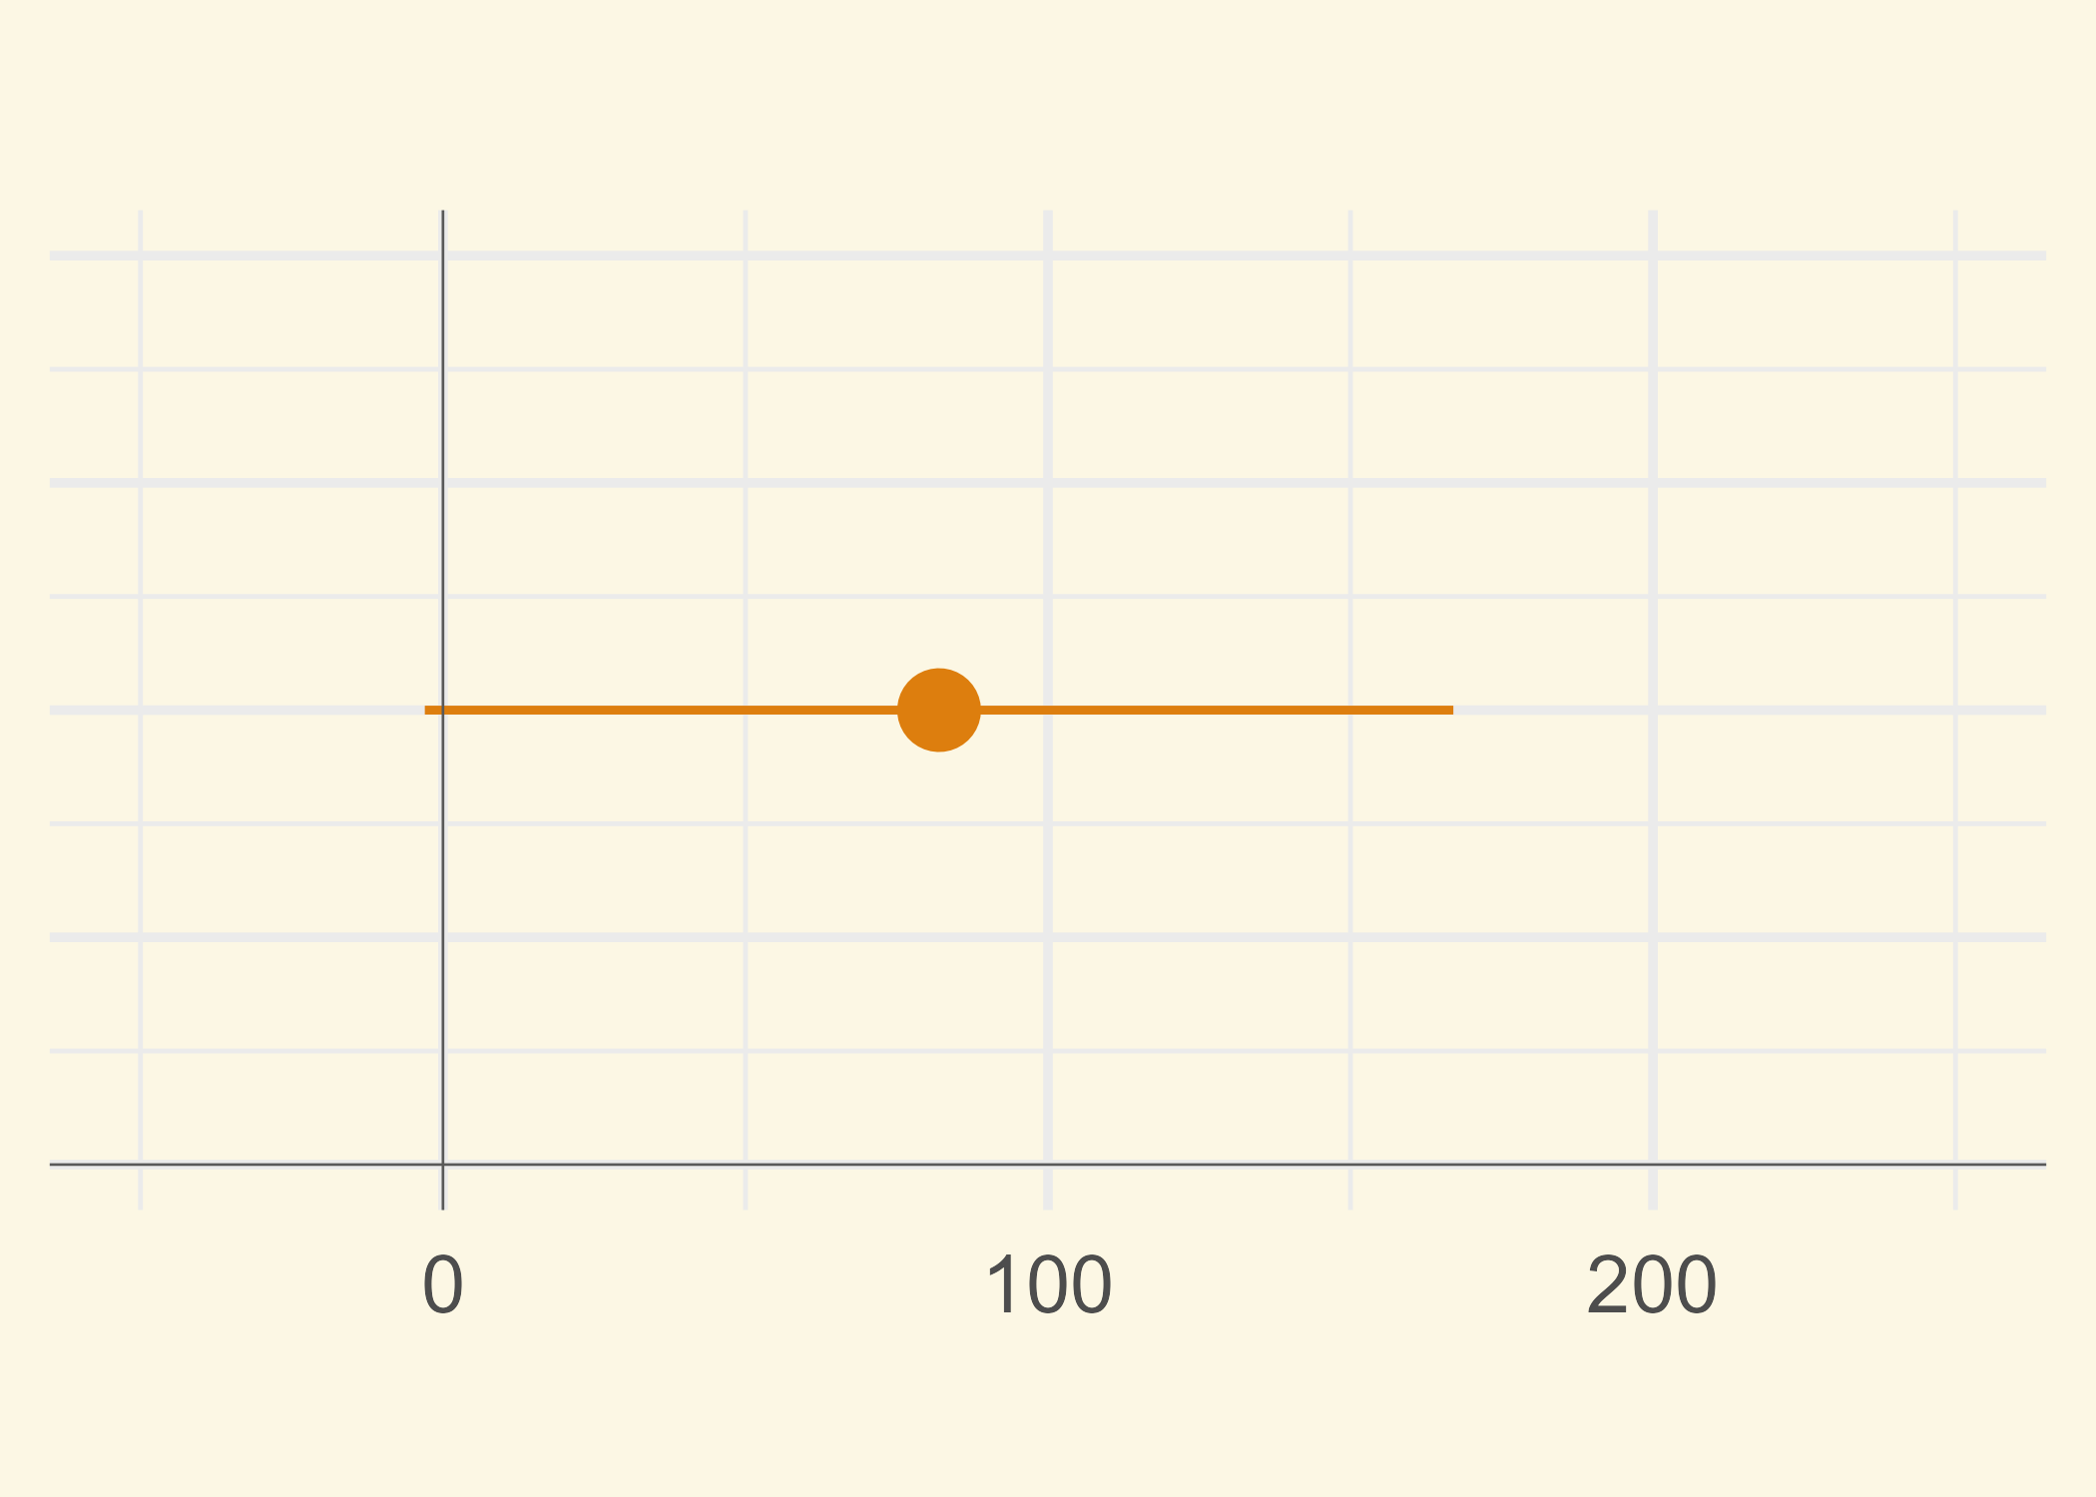
Sampling and Inference
What about p-values?
A p-value is a measure of how surprising your study results would be if the treatment truly had no effect.
A small p-value means the results would be unlikely to occur just by chance, and therefore provide evidence against the “no effect” assumption.
It does not tell you the size or importance of the effect, nor the probability that the treatment works.
Weak effect
Moderate
effect
Strong effect
p < 0.05
p-values should be treated with caution, as they encourage dichotomous thinking (“the drug works” vs. the “drug doesn’t work”). They should always be interpreted in conjunction with the CI.
In the upper example, the CI includes values that may be too small to be clinically meaningful, although the results are “statistically significant”.
Weak effect
Moderate
effect
Strong effect
p > 0.05
Pre-bronchodilator FEV1 change from baseline (mL)

Slide 20
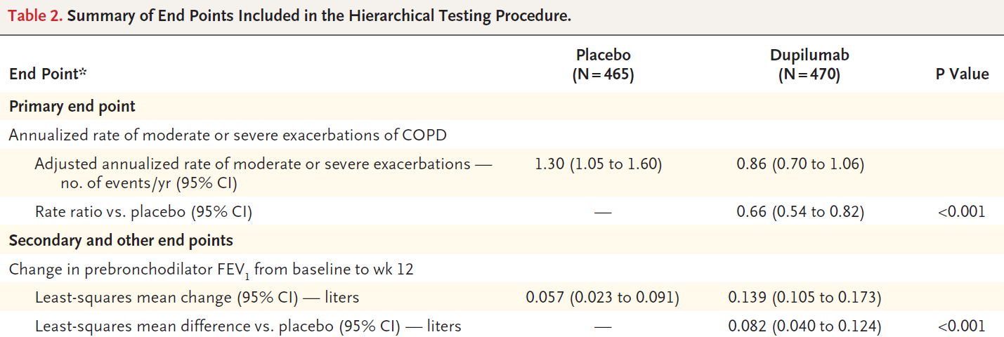
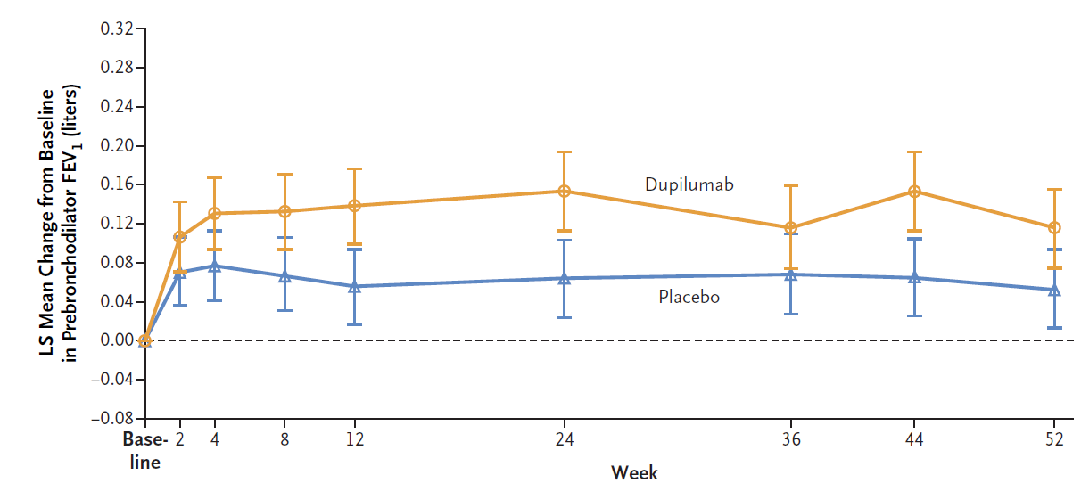
Sampling and Inference
Case Study: Effect of dupilumab versus placebo on mean change from baseline in prebronchodilator FEV₁ at week 12

